Slide 1
Constraint Satisfaction Problems

Slide 2
Motivation
Problems solved by searching in a space of states, which can be evaluated by heuristics and tested. Each state is atomic, or indivisible—a black box with no internal structure.
A factored representation for each state: a set of variables, each of which has a value. A problem is solved when each variable has a value that satisfies all the constraints on the variable.
Take advantage of the structure of states and use general purpose rather than problem-specific heuristics.
The main idea is to eliminate large portions of the search space all at once by identifying variable/value combinations that violate the constraints.

Slide 3
Outline
Constraint Satisfaction Problems (CSP)
Standard search
Improvements
Backtracking
Forward checking
Constraint propagation
Local search for CSP
Problem structure and decomposition

Slide 4
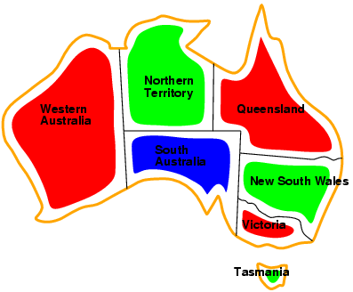
Graph Coloring

Slide 5
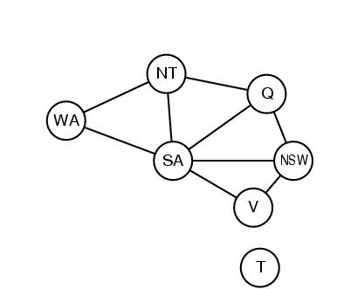

Slide 6
Sudoku Puzzle
 |  |  |  | 9 |  | 3
 | 2 |  | 6 |  | 1 | 5 | 9
3 |  |  | 5 |  | 8 |  | 2 | 4
 | 9 |  |  |  |  | 4 | 8
6 |  |  | 2 |  | 9 |  |  | 1
 | 5 | 2 |  |  |  |  | 3
9 | 7 |  | 1 |  | 5 |  |  | 3
 | 3 | 8 | 7 |  | 4 |  | 1
 |  | 5 |  | 8

Slide 7
Problem Formulation
What is the state space?
What is the initial state?
What is the successor function?
What is the goal test?
What is the path cost?

Slide 8
CSP as a Search Problem
A state is an assignment of values to some or all variables.
Consistent assignment: assignment does not violate the constraints.
Initial state: empty assignment
Successor function: a value is assigned to any unassigned variable, which does not conflict with the currently assigned variables
Goal test: the assignment is complete and consistent
Path cost: irrelevant

Slide 9
Constraint Satisfaction Problem
Set of variables {X₁, X₂, …, X_{n}}
Each variable Xi has a domain D_{i} of possible values
Usually D_{i} is discrete and finite
Set of constraints {C₁, C₂, …, C_{p}}
Each constraint C_{k} involves a subset of variables and specifies the allowable combinations of values of these variables
Goal: Assign a value to every variable such that all constraints are satisfied

Slide 10
Points
Branching factor b at the top level is nd.
b=(n-l)d at depth l, hence n!d ^{n} leaves (only d ^{n} complete assignments).
Large search space
Commutability
What about using bfs or dfs?
fixed depth
We can do better…….

Slide 11
What else is needed?
Not just a successor function and goal test
But also a means to propagate the constraints imposed by one move on the others and an early failure test
→ Explicit representation of constraints and constraint manipulation algorithms

Slide 12
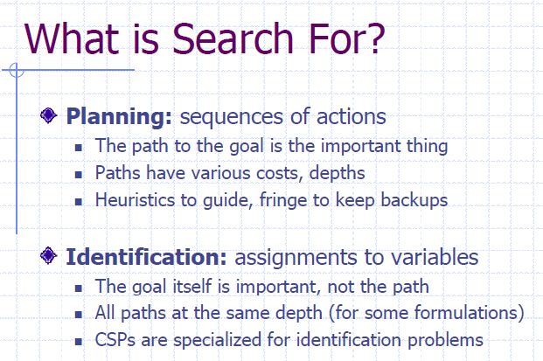

Slide 13
Example: Sudoku CSP
variables:
domains:
constraints:
Goal: Assign a value to every variable such that all constraints are satisfied

Slide 14
Example: Sudoku CSP
variables: X₁₁, …, X₉₉
domains: {1,…,9}
constraints:
row constraint: X₁₁ ≠ X₁₂, …, X₁₁ ≠ X₁₉
col constraint: X₁₁ ≠ X₁₂, …, X₁₁ ≠ X₁₉
block constraint: X₁₁ ≠ X₁₂, …, X₁₁ ≠ X₃₃
Goal: Assign a value to every variable such that all constraints are satisfied

Slide 15
Example: Graph Coloring
NT
NT
Q
Q
WA
WA
SA
SA
NSW
NSW
V
V
T
T
7 variables {WA,NT,SA,Q,NSW,V,T}
Each variable has the same domain {red, green, blue}
No two adjacent variables have the same value:
WA≠NT, WA≠SA, NT≠SA, NT≠Q, SA≠Q, SA≠NSW, SA≠V,Q≠NSW, NSW≠V

Slide 16
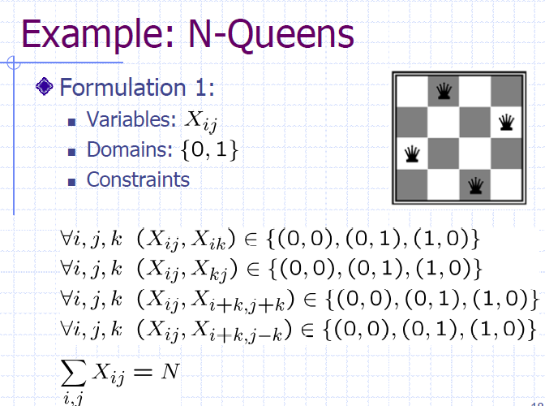

Slide 17
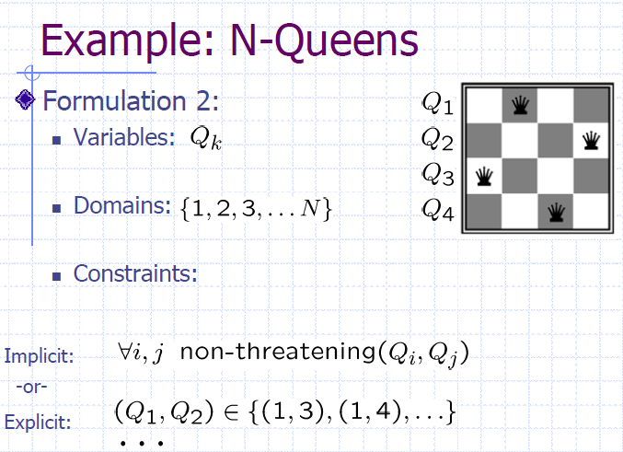

Slide 18
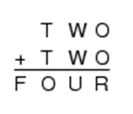
Example: Cryptarithmetic
Variables: F T U W R O
Domain: {0,1,2,3,4,5,6,7,8,9}
Constraints:
Alldiff (F,T,U,W,R,O)
O + O = R + 10 · X₁
X₁ + W + W = U + 10 · X₂
X₂ + T + T = O + 10 · X₃
X₃ = F, T ≠ 0, F ≠ 0
X₁ X₂ X₃

Slide 19
Example: Task Scheduling
T1
T2
T4
T3
T1 must be done during T3
T2 must be achieved before T1 starts
T2 must overlap with T3
T4 must start after T1 is complete
Are the constraints compatible?
Find the temporal relation between every two tasks

Slide 20
Applications
Scheduling the Hubble Space Telescope,
Floor planning for VLSI,
Map coloring,
Cryptography
etc.

Slide 21
Varieties of constraints
Unary constraints involve a single variable.
e.g. SA ≠ green
Binary constraints involve pairs of variables.
e.g. SA ≠ WA
Higher-order constraints involve 3 or more variables.
e.g. cryptharithmetic column constraints.
Preference (soft constraints) e.g. red is better than green often representable by a cost for each variable assignment → constrained optimization problems.

Slide 22
Constraint Graph
Binary constraints
What is the constraint graph for sudoku?
NT
Q
WA
SA
NSW
V
T
Two variables are adjacent or neighbors if they
are connected by an edge or an arc

Slide 23
Remark
Finite CSP include 3SAT as a special case (see class on logic)
3SAT is known to be NP-complete
So, in the worst-case, we cannot expect to solve a finite CSP in less than exponential time

Slide 24
Commutability of CSP
The order in which values are assigned
to variables is irrelevant to the final
assignment, hence:
Generate successors of a node by considering assignments for only one variable
Do not store the path to node

Slide 25

Outline
Constraint Satisfaction Problems (CSP)
Standard search
Improvements
Backtracking
Forward checking
Constraint propagation
Local search for CSP
Problem structure and decomposition

Slide 26
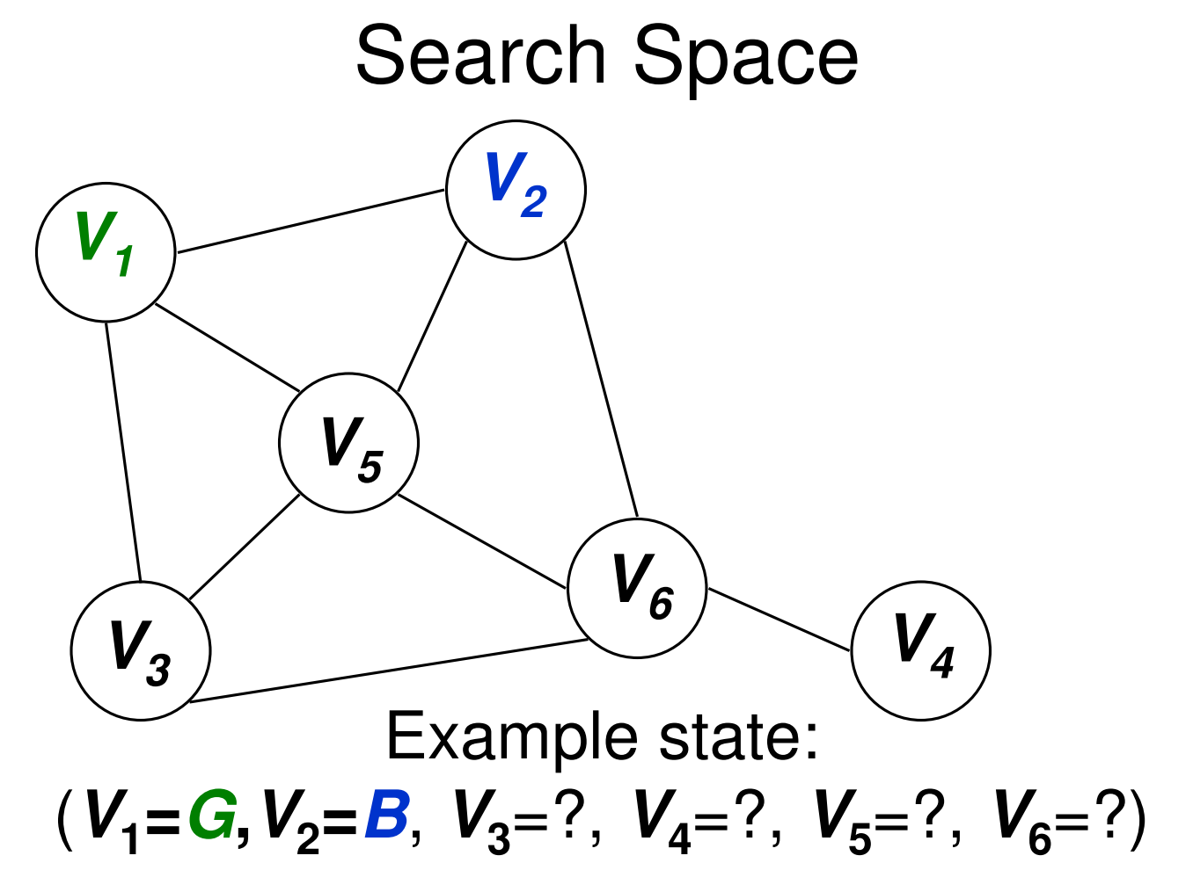

Slide 27
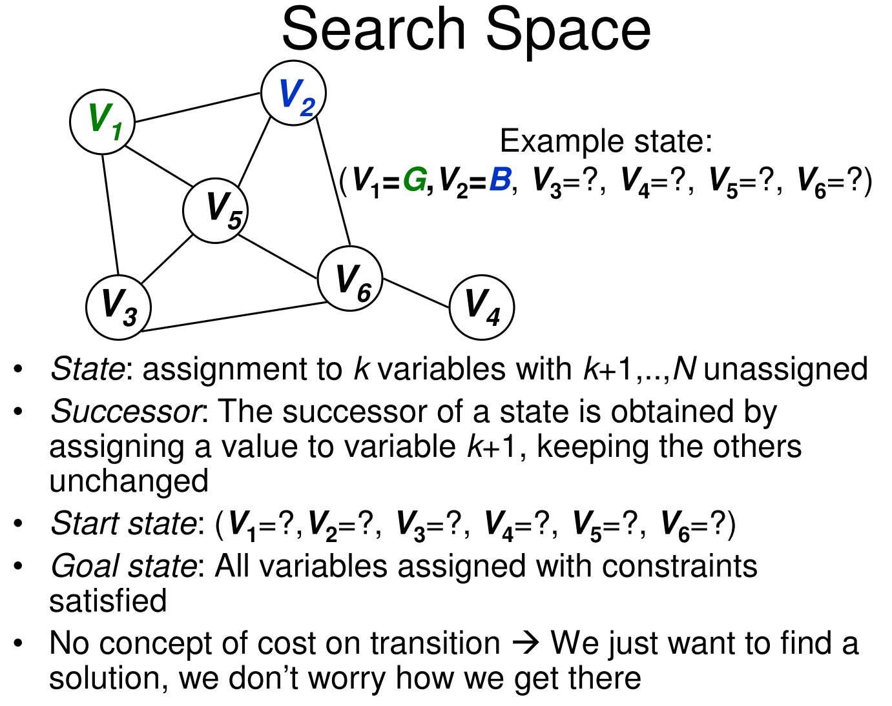

Slide 28
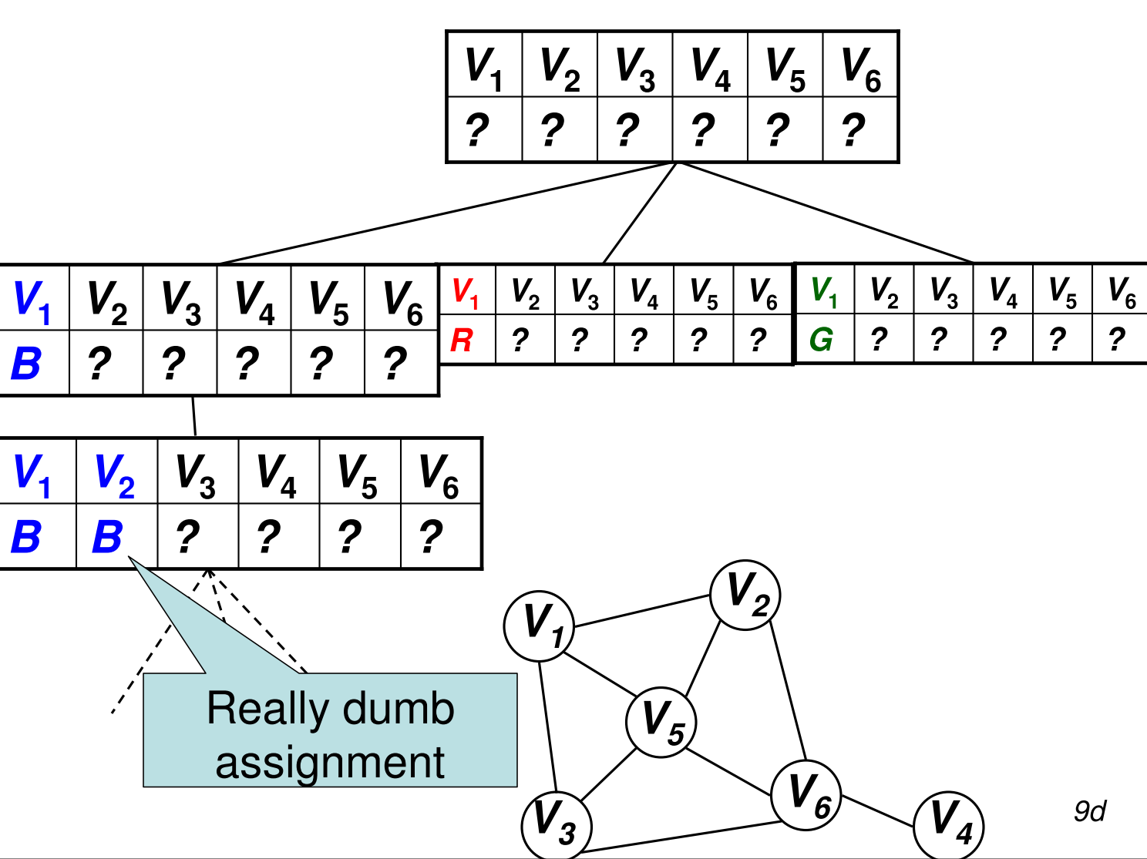

Slide 29
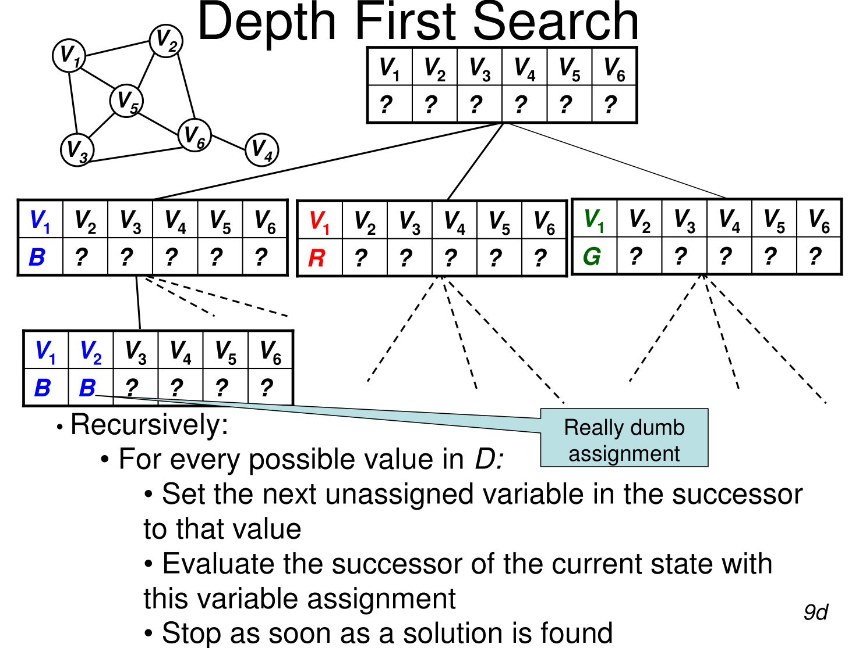

Slide 30
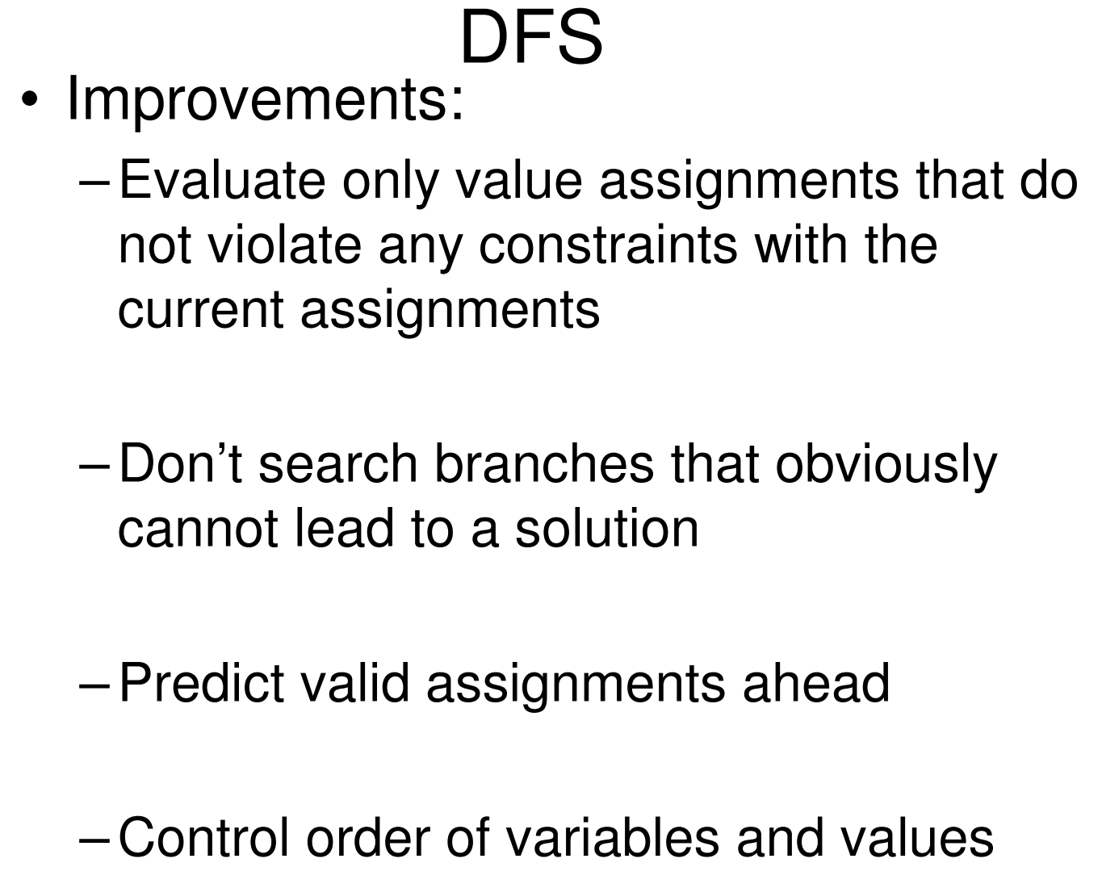

Slide 31
Outline
Constraint Satisfaction Problems (CSP)
Standard search
Improvements
Backtracking
Forward checking
Constraint propagation
Local search for CSP
Problem structure and decomposition

Slide 32
Backtracking Algorithm
partial assignment
of variables
CSP-BACKTRACKING({})
CSP-BACKTRACKING(a)
If a is complete then return a
X ← select unassigned variable
D ← select an ordering for the domain of X
For each value v in D do
If v is consistent with a then
Add (X= v) to a
result ← CSP-BACKTRACKING(a)
If result ≠ failure then return result
Return failure

Slide 33
→ Backtracking Search
empty assignment
1st variable
2nd variable
3rd variable
Assignment = {}

Slide 34
→ Backtracking Search
empty assignment
1st variable
2nd variable
3rd variable
Assignment = {(var1=v11)}

Slide 35
→ Backtracking Search
empty assignment
1st variable
2nd variable
3rd variable
Assignment = {(var1=v11),(var2=v21)}

Slide 36
→ Backtracking Search
empty assignment
1st variable
2nd variable
3rd variable
Assignment = {(var1=v11),(var2=v21),(var3=v31)}

Slide 37
→ Backtracking Search
empty assignment
1st variable
2nd variable
3rd variable
Assignment = {(var1=v11),(var2=v21),(var3=v32)}

Slide 38
→ Backtracking Search
empty assignment
1st variable
2nd variable
3rd variable
Assignment = {(var1=v11),(var2=v22)}

Slide 39
→ Backtracking Search
empty assignment
1st variable
2nd variable
3rd variable
Assignment = {(var1=v11),(var2=v22),(var3=v31)}

Slide 40
Map Coloring
{}
WA=red
WA=green
WA=blue
WA=red
NT=green
WA=red
NT=blue
NT
Q
WA
WA=red
NT=green
Q=red
WA=red
NT=green
Q=blue
SA
NSW
V
T

Slide 41
Questions
Which variable X should be assigned a value next?
In which order should its domain D be sorted?

Slide 42
Questions
Which variable X should be assigned a value next?
In which order should its domain D be sorted?
What are the implications of a partial assignment for yet unassigned variables? (→ Constraint Propagation)

Slide 43
Choice of Variable
Map coloring
NT
NT
Q
WA
WA
SA
SA
NSW
V
T

Slide 44
Choice of Variable
#1: Minimum Remaining Values (aka Most-constrained-variable heuristic or Fail First):
Select a variable with the fewest remaining values
What’s the reason?

Slide 45
Choice of Variable
NT
Q
WA
SA
SA
NSW
#2: Degree Heuristic:
Select the variable that is involved in the largest number of constraints on other unassigned variables
V
T

Slide 46
Choice of Value
NT
NT
Q
WA
WA
SA
NSW
V
{}
T

Slide 47
Choice of Value
NT
NT
Q
WA
WA
SA
NSW
V
{blue}
T
#3: Least-constraining-value heuristic:
Prefer the value that leaves the largest subset of legal values for other unassigned variables

Slide 48
Sudoku
Variable Selection:
Minimum Remaining Values?
Degree : NA
Value Selection:
Least constraining value?
Others?

Slide 49
Constraint Propagation …
… is the process of determining how the possible values of one variable affect the possible values of other variables
The key idea is local consistency. If we treat each variable as a node in a graph and each binary constraint as an arc, then the process of enforcing local consistency in each pan of the graph causes inconsistent values to be eliminated throughout the graph.

Slide 50
Forward Checking
After a variable X is assigned a value v, look at each unassigned variable Y that is connected to X by a constraint and deletes from Y’s domain any value that is inconsistent with v

Slide 51
Map Coloring: FC
NT
Q
WA
NSW
T
SA
V
WA | NT | Q | NSW | V | SA | T
RGB | RGB | RGB | RGB | RGB | RGB | RGB

Slide 52
Map Coloring: FC
NT
Q
WA
NSW
T
SA
V
WA | NT | Q | NSW | V | SA | T
RGB | RGB | RGB | RGB | RGB | RGB | RGB
1: R | RGB | RGB | RGB | RGB | RGB | RGB

Slide 53
Map Coloring: FC
NT
Q
WA
NSW
T
SA
V
WA | NT | Q | NSW | V | SA | T
RGB | RGB | RGB | RGB | RGB | RGB | RGB
1: R | RGB | RGB | RGB | RGB | RGB | RGB

Slide 54
Map Coloring: FC
NT
Q
WA
NSW
T
SA
V
WA | NT | Q | NSW | V | SA | T
RGB | RGB | RGB | RGB | RGB | RGB | RGB
R | RGB | RGB | RGB | RGB | RGB | RGB
R | RGB | 2: G | RGB | RGB | RGB | RGB

Slide 55
Map Coloring:FC
NT
Q
WA
NSW
T
SA
V
WA | NT | Q | NSW | V | SA | T
RGB | RGB | RGB | RGB | RGB | RGB | RGB
R | RGB | RGB | RGB | RGB | RGB | RGB
R | RGB | 2: G | RGB | RGB | RGB | RGB

Slide 56
Map Coloring: FC
NT
Q
WA
NSW
T
SA
V
WA | NT | Q | NSW | V | SA | T
RGB | RGB | RGB | RGB | RGB | RGB | RGB
R | RGB | RGB | RGB | RGB | RGB | RGB
R | RGB | G | RGB | RGB | RGB | RGB
R | RGB | G | RGB | 3:B | RGB | RGB

Slide 57
Map Coloring: FC
NT
Q
WA
NSW
T
SA
V
WA | NT | Q | NSW | V | SA | T
RGB | RGB | RGB | RGB | RGB | RGB | RGB
R | RGB | RGB | RGB | RGB | RGB | RGB
R | RGB | G | RGB | RGB | RGB | RGB
R | RGB | G | RGB | 3:B | RGB | RGB

Slide 58
Other inconsistencies?
NT
Q
WA
NSW
T
SA
V
Impossible assignments that forward
checking do not detect
WA | NT | Q | NSW | V | SA | T
RGB | RGB | RGB | RGB | RGB | RGB | RGB
R | RGB | RGB | RGB | RGB | RGB | RGB
R | RGB | G | RGB | RGB | RGB | RGB
R | RGB | G | RGB | 3:B | RGB | RGB

Slide 59
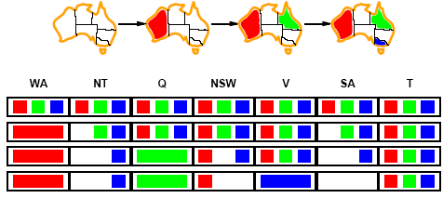
Constraint propagation
Solving CSPs with combination of heuristics plus forward checking is more efficient than either approach alone.
FC checking propagates information from assigned to unassigned variables but does not provide detection for all failures.
More advanced constraint propagation methods repeatedly enforces constraints locally

Slide 60
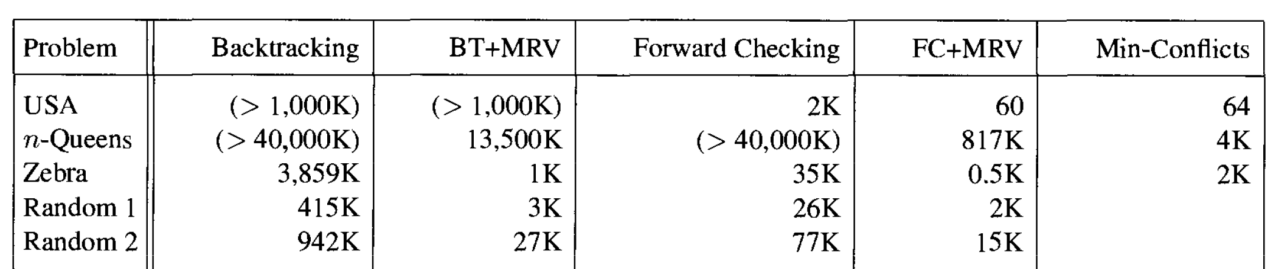
Comparison of different CSP algorithms

Slide 61
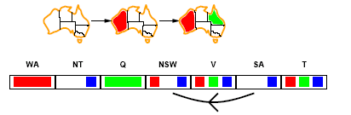
Arc consistency
NT
Q
WA
NSW
T
SA
V
X → Y is consistent iff
given the CURRENT domain, for every value x of X there is some allowed y
SA → NSW is consistent?
SA=blue and NSW=red

Slide 62
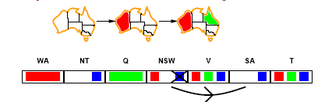
Arc consistency
NT
Q
WA
NSW
T
SA
V
X → Y is consistent iff
given the CURRENT domain, for every value x of X there is some allowed y
NSW → SA is consistent?
NSW=red and SA=blue NSW=blue and SA=???
Arc can be made consistent by removing blue from NSW

Slide 63
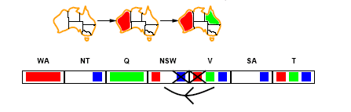
Arc consistency
NT
Q
WA
NSW
T
SA
V
Arc can be made consistent by removing blue from NSW
RECHECK neighbors of NSW!!
Remove red from V

Slide 64
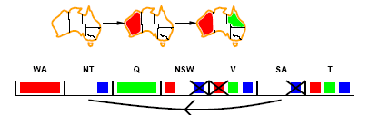
Arc consistency
NT
Q
WA
NSW
T
SA
V
Arc can be made consistent by removing blue from NSW
RECHECK neighbors of NSW!!
Remove red from V
Arc consistency detects failure earlier than FC
Can be run as a preprocessor or after each assignment.
Repeated until no inconsistency remains

Slide 65
Arc consistency algorithm
function AC-3(csp) return the CSP, possibly with reduced domains
inputs: csp, a binary csp with variables {X₁, X₂, …, X_{n}}
local variables: queue, a queue of arcs initially the arcs in csp
while queue is not empty do
(X_{i}, X_{j}) ← REMOVE-FIRST(queue)
if REMOVE-INCONSISTENT-VALUES(X_{i}, X_{j}) then
for each X_{k} in NEIGHBORS[X_{i} ] - X_{j} do
add (X_{k}, X_{i}) to queue
function REMOVE-INCONSISTENT-VALUES(X_{i}, X_{j}) return true iff we remove a value
removed ← false
for each x in DOMAIN[X_{i}] do
if no value y in DOMAIN[X_{j}] does (x, y) satisfy constraints between X_{i} and X_{j}
then delete x from DOMAIN[X_{i}];
removed ← true
return removed

Slide 66
Path consistency
Map-coloring of Australia with two colors —— is it arc consistent?
A two-variable set {X_{i}, X_{j}} is path-consistent with respect to a third variable X_{m} if, for every assignment { X_{i} = a, X_{j} = b} consistent with the constraints on {X_{i}, X_{j}}, there is an assignment to X_{m} that satisfies the constraints on {X_{i}, X_{m}} and {X_{m}, X_{j}}.
How path consistency fares in coloring the Australia map with two colors?

Slide 67
K-consistency
NT
Q
WA
SA
NSW
T
V
爲什麽？
Arc consistency can not detect all inconsistencies:
Partial assignment {WA=red, NSW=red} is inconsistent.
Stronger forms of propagation can be defined using the notion of k-consistency.
A CSP is k-consistent if for any set of k － 1 variables and for any consistent assignment to those variables, a consistent value can always be assigned to any k^{th} variable.
E.g. 1-consistency or node-consistency
E.g. 2-consistency or arc-consistency
E.g. 3-consistency or path-consistency

Slide 68
K-consistency
A graph is strongly k-consistent if
It is k-consistent and
Is also (k-1) consistent, (k-2) consistent, … all the way down to 1-consistent.
For a CSP with n variables which is strongly n-consistent, this is ideal since a solution can be found in time O(nd) instead of O(n²d³)
YET no free lunch: any algorithm for establishing n-consistency must take time exponential in n, in the worst case.

Slide 69
Further improvements
Intelligent backtracking
Standard form is chronological backtracking i.e. try different value for preceding variable.
More intelligent, backtrack to conflict set.
Set of variables that caused the failure or set of previously assigned variables that are connected to X by constraints.
Back-jumping moves back to most recent element of the conflict set.
Forward checking can be used to determine conflict set.

Slide 70
Outline
Constraint Satisfaction Problems (CSP)
Standard search
Improvements
Backtracking
Forward checking
Constraint propagation
Local search for CSP
Problem structure and decomposition

Slide 71
Local search for CSP
Use complete-state representation
For CSPs
allow states with unsatisfied constraints
operators reassign variable values
Variable selection: randomly select any conflicted variable
Value selection: min-conflicts heuristic
Select new value that results in a minimum number of conflicts with the other variables

Slide 72
Local Search for CSP
1
2
2
0
3
2
3
2
2
2
2
2
3
2
Pick initial complete assignment (at random)
Repeat
Pick a conflicted variable var (at random)
Set the new value of var to minimize the number of conflicts
If the new assignment is not conflicting then return it
(min-conflicts heuristics)

Slide 73
Local search for CSP
function MIN-CONFLICTS(csp, max_steps) return solution or failure
inputs: csp, a constraint satisfaction problem
max_steps, the number of steps allowed before giving up
current ← an initial complete assignment for csp
for i = 1 to max_steps do
if current is a solution for csp then return current
var ← a randomly chosen, conflicted variable from VARIABLES[csp]
value ← the value v for var that minimize CONFLICTS(var,v,current,csp)
set var = value in current
return failure

Slide 74
Comparison of different CSP algorithms

Slide 75
Remark
Local search with min-conflict heuristic works extremely well for million-queen problems
The reason: Solutions are densely distributed in the O(n^{n}) space, which means that on the average a solution is a few steps away from a randomly picked assignment

Slide 76
Outline
Constraint Satisfaction Problems (CSP)
Standard search
Improvements
Backtracking
Forward checking
Constraint propagation
Local search for CSP
Problem structure and decomposition

Slide 77
Problem structure
How can the problem structure help to find a solution quickly?
Subproblem identification is important:
Coloring Tasmania and mainland are independent subproblems
Identifiable as connected components of constrained graph.
Improves performance

Slide 78
Problem structure
Suppose each problem has c variables out of a total of n.
Worst case solution cost is O(n/c d^{c}), i.e. linear in n
Instead of O(d ^{n}), exponential in n
E.g. n= 80, c= 20, d=2
2⁸⁰ = 4 billion years at 1 million nodes/sec.
4 * 2²⁰= .4 second at 1 million nodes/sec

Slide 79
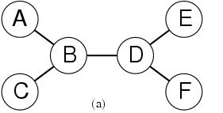
Tree-structured CSPs
Theorem: if the constraint graph has no loops (i.e. Tree) then CSP can be solved in O(nd ²) time
Compare difference with general CSP, where worst case is O(d ^{n})

Slide 80
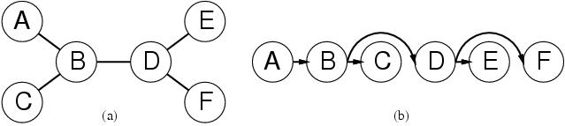
Tree-structured CSPs
In most cases subproblems of a CSP are connected as a tree
Any tree-structured CSP can be solved in time linear in the number of variables.
Choose a variable as root, order variables from root to leaves such that every node’s parent precedes it in the ordering. (label var from X₁ to X_{n})
For j from n down to 2, apply REMOVE-INCONSISTENT-VALUES(Parent(X_{j}),X_{j})
For j from 1 to n assign X_{j} consistently with Parent(X_{j} )

Slide 81
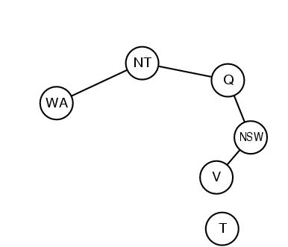
Nearly tree-structured CSPs
Can more general constraint graphs be reduced to trees?
Two approaches:
Remove certain nodes
Collapse certain nodes

Slide 82
Nearly tree-structured CSPs
Idea: assign values to some variables so that the remaining variables form a tree.
Assume that we assign {SA=x} ← cycle cutset
And remove any values from the other variables that are inconsistent.
The selected value for SA could be the wrong one so we have to try all of them

Slide 83
Nearly tree-structured CSPs
This approach is worthwhile if cycle cutset is small.
Finding the smallest cycle cutset is NP-hard
Approximation algorithms exist
This approach is called cutset conditioning.

Slide 84
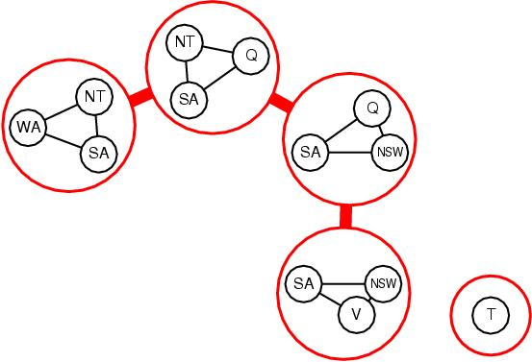
Nearly tree-structured CSPs
Tree decomposition of the constraint graph in a set of connected subproblems.
Each subproblem is solved independently
Resulting solutions are combined.
Necessary requirements:
Every variable appears in at least one of the subproblems.
If two variables are connected in the original problem, they must appear together in at least one subproblem.
If a variable appears in two subproblems, it must appear in each subproblem on the path.

Slide 85
Applications
CSP techniques allow solving very complex problems
Numerous applications, e.g.:
Crew assignments to flights
Management of transportation fleet (船隊)
Flight/rail schedules
Task scheduling in port operations
Design
Brain surgery
See www.ilog.com

Slide 86
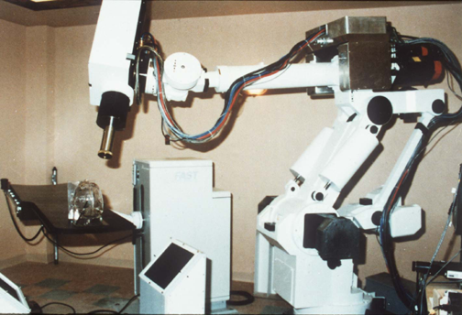
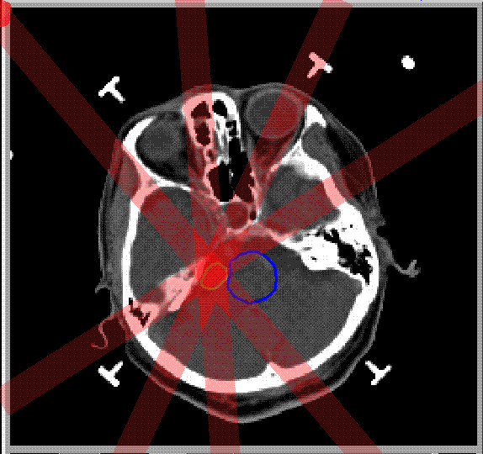
Stereotaxic Brain Surgery

Slide 87
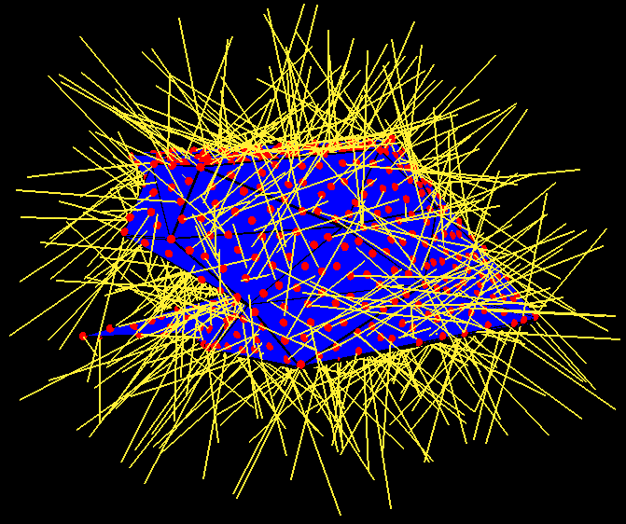
Stereotaxic Brain Surgery
• 2000 < Tumor < 2200
2000 < B2 + B4 < 2200
2000 < B4 < 2200
2000 < B3 + B4 < 2200
2000 < B3 < 2200
2000 < B1 + B3 + B4 < 2200
2000 < B1 + B4 < 2200
2000 < B1 + B2 + B4 < 2200
2000 < B1 < 2200
2000 < B1 + B2 < 2200
T
B1
T
B2
C
B4
B3
• 0 < Critical < 500
0 < B2 < 500

Slide 88
→ Constraint Programming
“Constraint programming represents one of the closest approaches computer science has yet made to the Holy Grail of programming: the user states the problem, the computer solves it.”
Eugene C. Freuder, Constraints, April 1997

Slide 89
When to Use CSP Techniques?
When the problem can be expressed by a set of variables with constraints on their values
When constraints are relatively simple (e.g., binary)
When constraints propagate well (AC3 eliminates many values)
Local Search: when the solutions are “densely” distributed in the space of possible assignments

Slide 90
Summary
CSPs are a special kind of problem: states defined by values of a fixed set of variables, goal test defined by constraints on variable values
Backtracking=depth-first search with one variable assigned per node
Variable ordering and value selection heuristics help significantly
Forward checking prevents assignments that lead to failure.
Constraint propagation does additional work to constrain values and detect inconsistencies.
The CSP representation allows analysis of problem structure.
Tree structured CSPs can be solved in linear time.
Local Search, e.g., min-conflicts, is often effective in practice.

